Slide 1

PREDICTING BONE FRACTURE RISK IN WOMEN with osteoporosis: A CLASSIFICATION MODELING APPROACH
Todd garner | mai dang | Carlos estevez

Slide 2


Agenda
STAt2_FINAL PROJECT
DATA Pre-PROCESSING
Exploratory DATA ANALYSIS
Objective 1
Objective 2
Conclusion

Slide 3
Agenda
STAt2_FINAL PROJECT
DATA pre-PROCESSING
EXPLORATORY DATA ANALYSIS
Objective 1
Objective 2
Conclusion

Slide 4
Agenda
STAt2_FINAL PROJECT
DATA pre-PROCESSING
EXPLORATORY DATA ANALYSIS
Objective 1
Objective 2
Conclusion

Slide 5
Agenda
STAt2_FINAL PROJECT
DATA pre-PROCESSING
EXPLORATORY DATA ANALYSIS
Objective 1
Objective 2
Conclusion

Slide 6
Agenda
STAt2_FINAL PROJECT
DATA pre-PROCESSING
EXPLORATORY DATA ANALYSIS
Objective 1
Objective 2
Conclusion

Slide 7


DATA PRE-PROCESSING
STAt2_FINAL PROJECT
DATASET
VARIABLES
MISSING VALUES?

Slide 8
DATA PRE-PROCESSING
STAt2_FINAL PROJECT
DATASET
VARIABLES
MISSING VALUES?

Slide 9
DATA PRE-PROCESSING
STAt2_FINAL PROJECT
DATASET
VARIABLES
MISSING VALUES?

Slide 10
DATASET*
STAt2_FINAL PROJECT
GLOW_BONEMED
DATASET ​*
APLORE3 ​R LIBRARY
PROBLEM
statement
500 OBSERVATIONS AND 18 VARIABLES
375 NO BONE FRACTURE
125 BONE FRACTURE
WHERE DO We find it?
what do we want to know?
What do we have?
Unbalanced dataset
*
THE GLOBAL LONGITUDINAL STUDY OF OSTEOPOROSIS IN WOMEN (GLOW): RATIONALE AND STUDY DESIGN - PUBMED (NIH.GOV)

Slide 11
VARIABLES
STAt2_FINAL PROJECT
RATERISK, MOMFRAC,
PRIORFRAC, SMOKE,
PREMENO, ARMASSISST,
BONEMED, BONEMED_FU,
BONETREAT
SUB_ID
SITE_ID
PHY_ID
FRACTURE
YES / NO
AGE, WEIGHT, HEIGHT, BMI, FRACSCORE
response variables
Numerical variables
Categorical variables
Non- Predictive variables

Slide 12
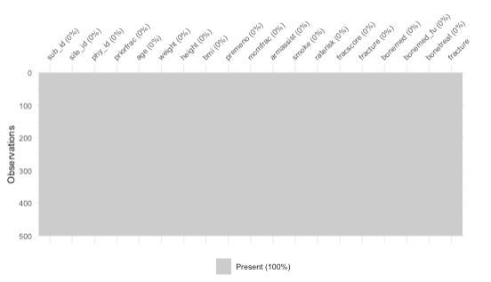
MISSING VALUES ?

Slide 13
EDA
STAt2_FINAL PROJECT
NUMERICAL VARIABLES – LOESS CURVES
CATEGORICAL VARIABLES – BARPLOTS
SCATTER PLOT MATRIX
MULTICOLLINEARITY
VARIABLE DISTRIBUTIONS
DECISION BOUNDARIES

Slide 14
EDA
STAt2_FINAL PROJECT
NUMERICAL VARIABLES – LOESS CURVES
CATEGORICAL VARIABLES – BARPLOTS
SCATTER PLOT MATRIX
MULTICOLLINEARITY
VARIABLE DISTRIBUTIONS
DECISION BOUNDARIES

Slide 15
EDA
STAt2_FINAL PROJECT
NUMERICAL VARIABLES – LOESS CURVES
CATEGORICAL VARIABLES – BARPLOTS
SCATTER PLOT MATRIX
MULTICOLLINEARITY
VARIABLE DISTRIBUTIONS
DECISION BOUNDARIES

Slide 16
EDA
STAt2_FINAL PROJECT
NUMERICAL VARIABLES – LOESS CURVES
CATEGORICAL VARIABLES – BARPLOTS
SCATTER PLOT MATRIX
MULTICOLLINEARITY
VARIABLE DISTRIBUTIONS
DECISION BOUNDARIES

Slide 17
EDA
STAt2_FINAL PROJECT
NUMERICAL VARIABLES – LOESS CURVES
CATEGORICAL VARIABLES – BARPLOTS
SCATTER PLOT MATRIX
MULTICOLLINEARITY
VARIABLE DISTRIBUTIONS
DECISION BOUNDARIES

Slide 18
EDA
STAt2_FINAL PROJECT
NUMERICAL VARIABLES – LOESS CURVES
CATEGORICAL VARIABLES – BARPLOTS
SCATTER PLOT MATRIX
MULTICOLLINEARITY
VARIABLE DISTRIBUTIONS
DECISION BOUNDARIES

Slide 19
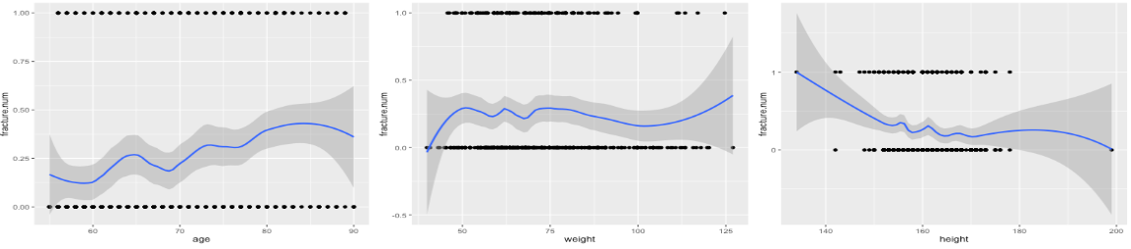
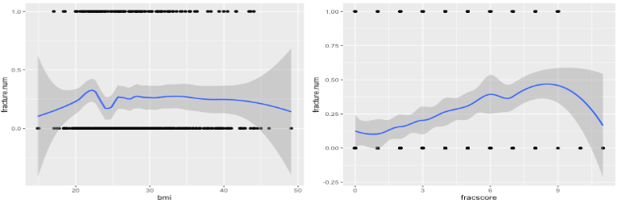
STAt2_FINAL PROJECT
NUMERICAL VARIABLES

Slide 20
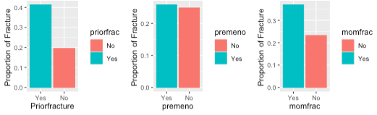
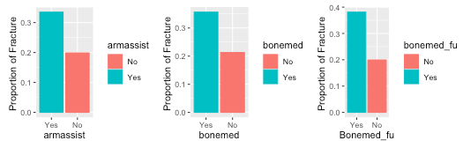
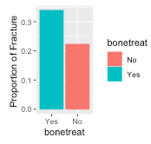
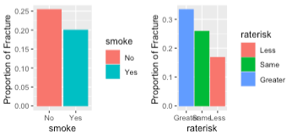
CATEGORICAL VARIABLES
STAt2_FINAL PROJECT
Not significant

Slide 21
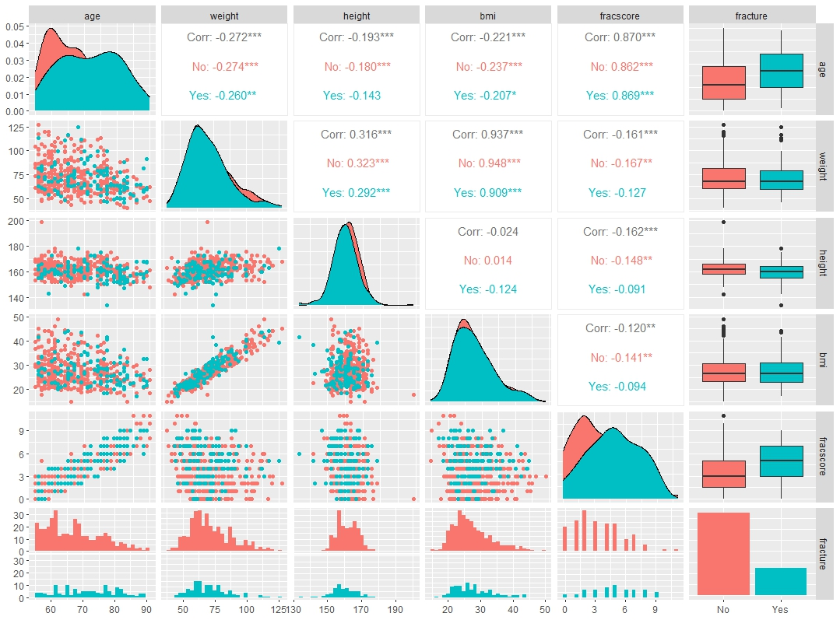
SCATTER PLOT MATRIX
STAt2_FINAL PROJECT
Multicollinearity issue

Slide 22
SCATTER PLOT MATRIX
STAt2_FINAL PROJECT
Nonnormal distribution !

Slide 23
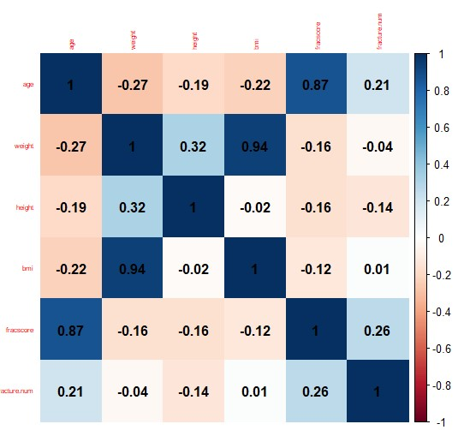
MULTICOLLINEARITY
STAt2_FINAL PROJECT
Multicollinearity issue!

Slide 24
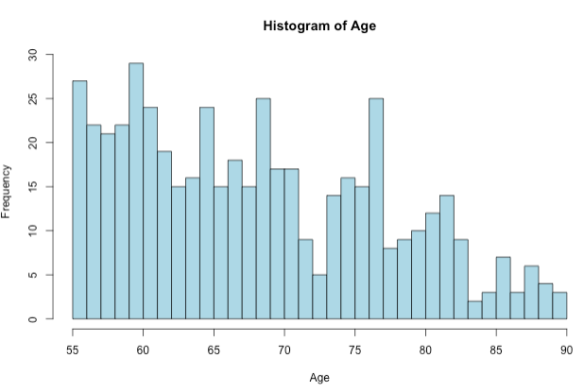
Distributions
STAt2_FINAL PROJECT
Right skewed ​
LDA

Slide 25
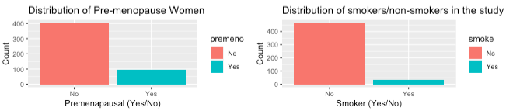
DISTRIBUTIONS
STAt2_FINAL PROJECT
Unbalanced between Yes and No

Slide 26
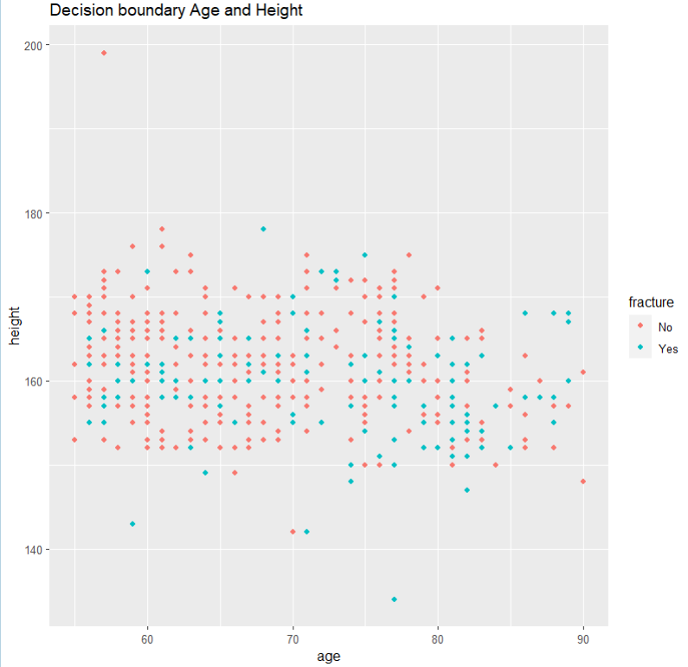
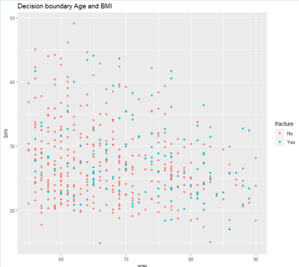
DECISION BOUNDARY
STAt2_FINAL PROJECT
No clear boundary

Slide 27
Objective 1
STAt2_FINAL PROJECT
MODEL FITTING APPROACH
FEATURE SELECTION
FINAL ADDITIVE MODEL
INTERPRETATION
Notes:
Let's move forward to the first objective of the project, which is to build the best interpretable model, a model we can interpret the assosication of each coefficients the chance thay a woman with osteoporosis may or may not experience a bone fracture within a year.
We use the EDA or explanatory dataset analysis to decide our model fitting approach, we implement feature selection tool to get the best set of predictors. Once we have the best interpretable model, we will dive in the predictors fitted in the model and conclude the first objective 1 with the interpretations of a few coefficients in the model.

Slide 28
Objective 1
STAt2_FINAL PROJECT
MODEL FITTING APPROACH
FEATURE SELECTION
FINAL ADDITIVE MODEL
INTERPRETATION
Notes:
Let's move forward to the first objective of the project, which is to build the best interpretable model.
We will use the EDA or explanatory dataset analysis to decide our model fitting approach, we will also implement feature selection tool to get the best set of predictors. Once we have the best interpretable model, we will dive in the predictors fitted in the model and conclude the first objective 1 with the interpretations of a few coefficients in the model.

Slide 29
Objective 1
STAt2_FINAL PROJECT
MODEL FITTING APPROACH
FEATURE SELECTION
FINAL ADDITIVE MODEL
INTERPRETATION
Notes:
Let's move forward to the first objective of the project, which is to build the best interpretable model.
We will use the EDA or explanatory dataset analysis to decide our model fitting approach, we will also implement feature selection tool to get the best set of predictors. Once we have the best interpretable model, we will dive in the predictors fitted in the model and conclude the first objective 1 with the interpretations of a few coefficients in the model.

Slide 30
Objective 1
STAt2_FINAL PROJECT
MODEL FITTING APPROACH
FEATURE SELECTION
FINAL ADDITIVE MODEL
INTERPRETATION
Notes:
Let's move forward to the first objective of the project, which is to build the best interpretable model.
We will use the EDA or explanatory dataset analysis to decide our model fitting approach, we will also implement feature selection tool to get the best set of predictors. Once we have the best interpretable model, we will dive in the predictors fitted in the model and conclude the first objective 1 with the interpretations of a few coefficients in the model.

Slide 31



Model fitting approach
Study design
Retrospective sampling
Moderate sample size
STAt2_FINAL PROJECT
Model Design
Classification Model/ Logistic Regression
Train 80% + Validate 20%
Metrics
Log-Loss
Area under the Curve (AUC)
AIC
Notes:
In this study, the response variable which is the fracture is fixed. We know who had a bone fracture within the first year since the study. The predictors are the information collected at the time of the enrollment, including the age, weight and whether the observations is taking bone medication at the time. Therefore, this is a retrospective study. And with a moderate sample size, it is appropriate to interpret the odds ratio of the women with osteoporosis to have a bone fracture within a year of the study.

Slide 32


Model fitting approach
Study design
Retrospective sampling
Moderate sample size
STAt2_FINAL PROJECT
Model Design
Classification Model/ Logistic Regression
Train 80% + Validate 20%
Metrics
Log-Loss
Area under the Curve (AUC)
AIC
Notes:
Since the response is a categorical value, we decide to build a classification model. For the objective 1, which is to build a highly interpretable model, we will focus on a parametric classification model, particularly a logistic regression model.

Slide 33


Model fitting approach
Study design
Retrospective sampling
Moderate sample size
STAt2_FINAL PROJECT
Model Design
Classification Model/ Logistic Regression
Train 80% + Validate 20%
Metrics
Log-Loss
Area under the Curve (AUC)
AIC
Notes:
Since the response is a categorical value, we decide to build a classification model. For the objective 1, which is to build a highly interpretable model, we will focus on a parametric classification model, particularly a logistic regression model.

Slide 34
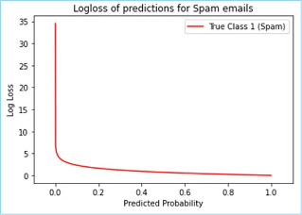
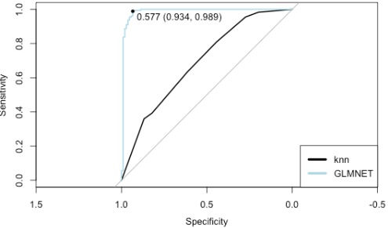
Metrics
Log-loss
AUc (Area under the curve)
The lower, the better
The greater, the better

Slide 35
Models trained
STAt2_FINAL PROJECT
FULL MODEL
CUSTOM MODEL
Stepwise
GLMNET
All predictors
Based on the eda
Feature selection
Feature selection

Slide 36
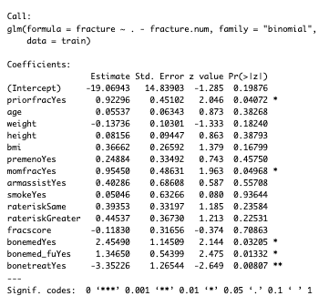
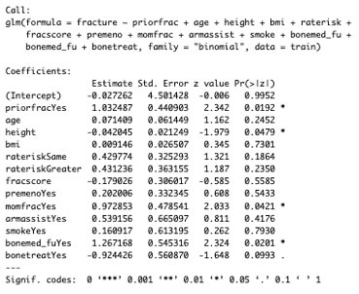

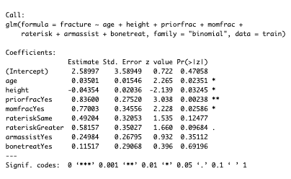
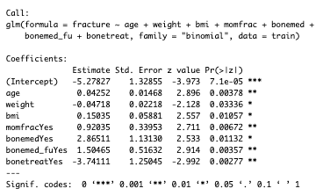
Model comparisons
STAt2_FINAL PROJECT
Full Model
GLMnet Model
Custom Model
Stepwise Model

Slide 37

summary
Model | predictors | AIC | accuracy | LogLoss | AUC
Full model | 14 predictors | 420.1 | 73% | 0.52 | 0.68
Custom Model | 7 predictors | 420.9 | 72% | 0.53 | 0.69
Stepwise | 8 predictors | 417.58 | 74% | 0.54 | 0.68
GLMnet | 13 predictors | 424.7 | 75% | 0.51 | 0.70

Slide 38
summary
Model | predictors | AIC | accuracy | LogLoss | AUC
Full model | 14 predictors | 420.1 | 73% | 0.52 | 0.68
Custom Model | 7 predictors | 420.9 | 72% | 0.53 | 0.69
Stepwise | 8 predictors | 417.58 | 74% | 0.54 | 0.68
GLMnet | 13 predictors | 424.7 | 75% | 0.51 | 0.70
age + height + priorfrac + momfrac + raterisk +armassist +bonetreat
age + weight + bmi + momfrac + bonemed + bonemed_fu + bonetreat
priorfrac + age + height + bmi +raterisk +fracscore + premeno + momfrac + armassist + smoke + bonemed + bonemed_fu + bonetreat

Slide 39
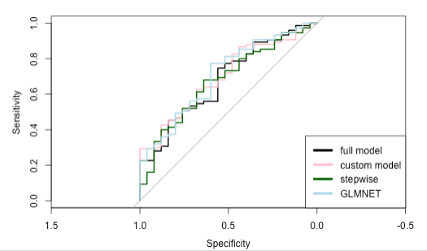
AUC Plot
STAt2_FINAL PROJECT

Slide 40
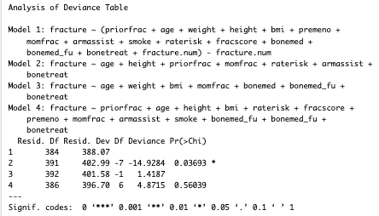
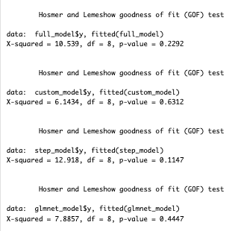
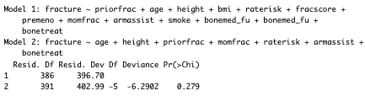
Tests
STAt2_FINAL PROJECT
ANOVA TEST
HOSMER LEMESHOW TEST (LACK OF FIT TEST)
Anova test
Hosmer Lemme show

Slide 41
Tests
STAt2_FINAL PROJECT
ANOVA TEST
HOSMER LEMESHOW TEST (LACK OF FIT TEST)
Anova test
Hosmer Lemme show

Slide 42
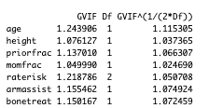
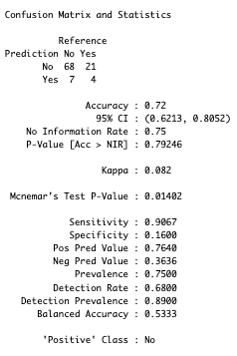
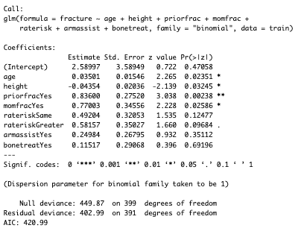
Final additive model
STAt2_FINAL PROJECT
Statistically significant

Slide 43
Final additive model
STAt2_FINAL PROJECT
VIFs ARE GOOD

Slide 44
Final additive model
STAt2_FINAL PROJECT
Concerning!!

Slide 45
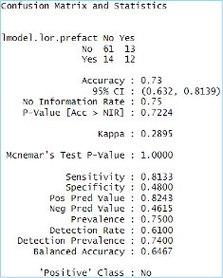
THRESHOLD =0.3
STAt2_FINAL PROJECT

Slide 46
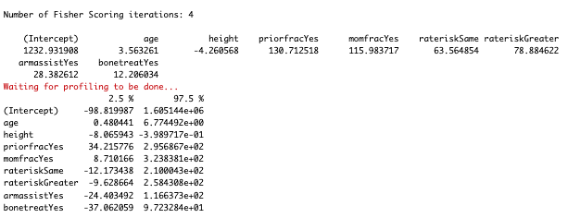
coefficients
STAt2_FINAL PROJECT
Practically insignificant

Slide 47
interpretation
STAt2_FINAL PROJECT
AGE
Mom FRACTURE
There is significant impact of the age in the odds ratio of having a bone fracture for the women with osteoporosis (p-value = 0.024), holding the other variables constant.
For an additional year in age, it is estimated that the odds ratio increases 3.56% holding all other variables constant. 95% CI is (0.48%, 6.77%)
There is a significant difference in the odds ratio of having a bone fracture within the five-year study in women with osteoporosis if their mom also had it, holding the other variables constant.
It is estimated that women with osteoporosis whose mothers also experienced a bone fracture have an odds 116% higher than those who didn't, holding all other variables constant. 95% CI(8%, 323%)

Slide 48
Objective 2
STAt2_FINAL PROJECT
DECISION BOUNDARY EXAMINATION
MODEL APPROACH WITH INTERACTIVE TERMS
EVALUATION METRICS
MODEL COMPARISONS
INSIGHTS ABOUT THE BEST MODEL

Slide 49
Objective 2
STAt2_FINAL PROJECT
DECISION BOUNDARY EXAMINATION
MODEL APPROACH WITH INTERACTIVE TERMS
EVALUATION METRICS
MODEL COMPARISONS
INSIGHTS ABOUT THE BEST MODEL

Slide 50
Objective 2
STAt2_FINAL PROJECT
DECISION BOUNDARY EXAMINATION
MODEL APPROACH WITH INTERACTIVE TERMS
EVALUATION METRICS
MODEL COMPARISONS
INSIGHTS ABOUT THE BEST MODEL

Slide 51
Objective 2
STAt2_FINAL PROJECT
DECISION BOUNDARY EXAMINATION
MODEL APPROACH WITH INTERACTIVE TERMS
EVALUATION METRICS
MODEL COMPARISONS
INSIGHTS ABOUT THE BEST MODEL

Slide 52
Objective 2
STAt2_FINAL PROJECT
DECISION BOUNDARY EXAMINATION
MODEL APPROACH WITH INTERACTIVE TERMS
EVALUATION METRICS
MODEL COMPARISONS
INSIGHTS ABOUT THE BEST MODEL

Slide 53
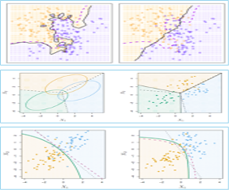
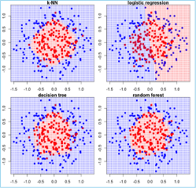


Decision boundary
STAt2_FINAL PROJECT
Definition:
•A decision boundary delineates the boundaries of classes
•Classifiers create decision boundaries to discriminate between classes
•Different classifiers are able to create different shapes of decision boundaries (e.g., some are strictly linear)
•Some classifiers may perform better for certain datasets
•Types of Decision Boundaries: Linear and Non-Linear
•Parametric models perform well for Linear Decision boundary
•Non-parametric models are effective for Non-Linear decision boundaries

Slide 54
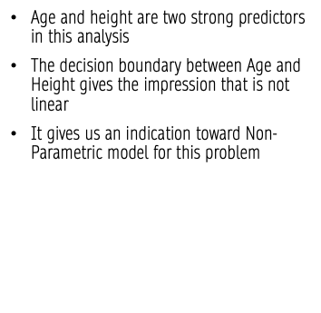
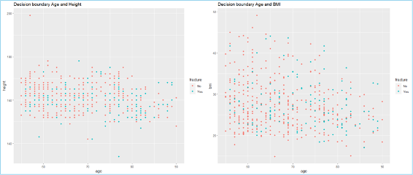
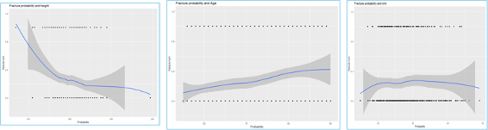
EDA RECAP
STAt2_FINAL PROJECT

Slide 55
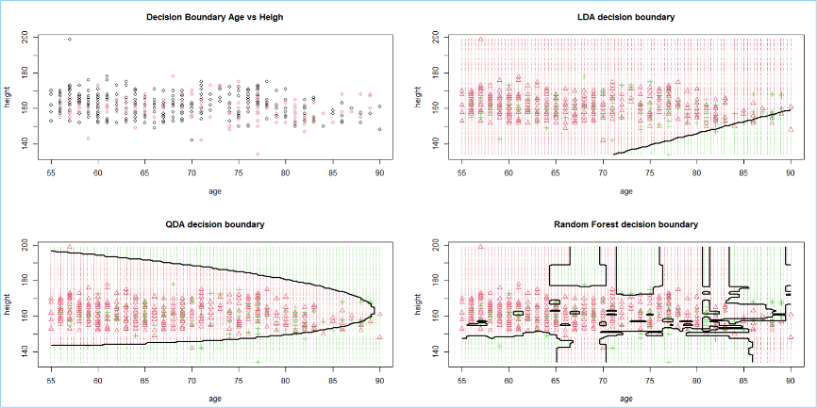
DECISION BOUNDAry
STAt2_FINAL PROJECT

Slide 56
DECISION BOUNDARY
STAt2_FINAL PROJECT

Slide 57
DECISION BOUNDARY
STAt2_FINAL PROJECT

Slide 58
DECISION BOUNDARY
STAt2_FINAL PROJECT

Slide 59
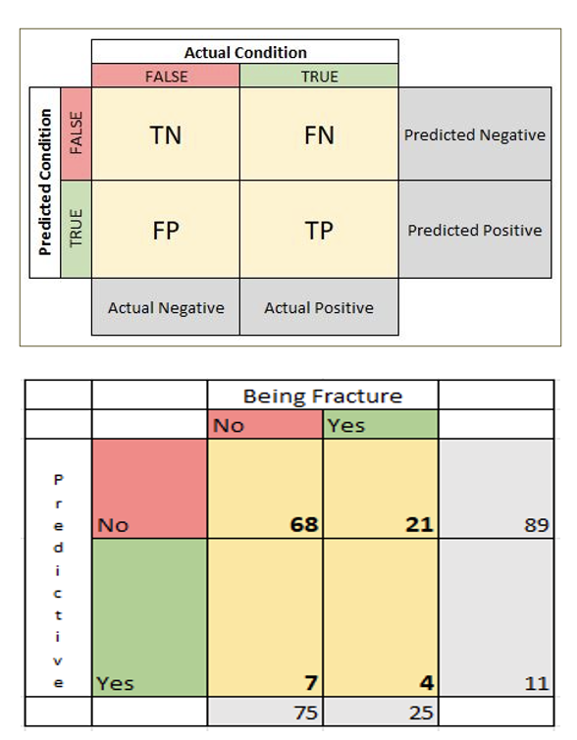
Evalutation metrics
STAt2_FINAL PROJECT
POSITIVE CLASS: “NO”​
​
ACCURACY: NUMBER OF CORRECT ASSESSMENTS DIVIDED BY THE NUMBER OF ASSESSMENTS​
​
THE SENSITIVITY: IN THIS CASE, THE PROPORTION OF WOMEN PREDICTED NOT BEING FRACTURED THAT ARE NOT REALLY FRACTURED​
​
THE SPECIFICITY: IN THIS CASE, THE PROPORTION OF WOMEN PREDICTED BEING FRACTURED THAT ARE REALLY FRACTURED​
​
PPV(POSITIVE PREDICTIVE VALUE): THE ODDS OF BEING FRACTURED GIVEN ONE WOMAN IS REALLY FRACTURED. IT FOCUSES ON THE PROBABILITY OF BEING FRACTURED OR NOT IF THE TEST IS POSITIVE OR NEGATIVE​
​
NPV(NEGATIVE PREDICTED VALUE): THE ODDS OF NOT HAVING NOT HAVING A FRACTURE GIVEN ONE WOMAN DOESN’T HAVE A FRACTURE
​
PREVALENCE: THE PROPORTION OF A POPULATION THAT IS AFFECTED BY A PARTICULAR DISEASE AT A GIVEN TIME. IF 75 WOMEN DON’T HAVE THE DISEASE OUT OF 100 THEN THE PREVALENCE IS 75%​.
It will provide information about whether the dataset is balanced or not (50% normal), in this case, the dataset has more observation in the category “No”, so it gives us an indication of whether we will have to adjust the threshold

Slide 60
Evalutation metrics
STAt2_FINAL PROJECT
Log-Loss: Log-loss is indicative of how close the prediction probability is to the corresponding actual. The more the predicted probability diverges from the actual value, the higher the log-loss value.
ROC-AUC is indicative of the degree of separability/distinction or intermingling/crossover between the predictions of the two classes. A model whose predictions are 100% wrong has an AUC of 0.0. One whose predictions are 100% correct has an AUC of 1.0
Importance of measuring AUC and Log-Loss
A decline in the log-loss score does not necessarily mean a change in the ROC-AUC score. As long as the degree of distinction between the predictions of the two classes remains the same, ROC-AUC stands still

Slide 61


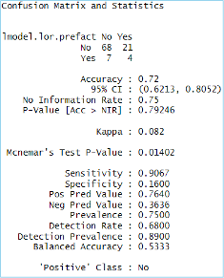
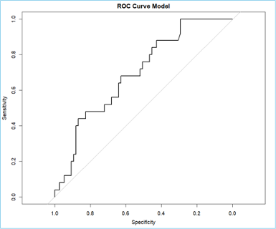
Recap and threshold decision
STAt2_FINAL PROJECT

Slide 62

Analysis of different models
Models to evaluate
Simple model (Using GLMNet)
Complex model (Interaction terms)
A model using QDA
A Non-Parametric model using Random Forest

Slide 63
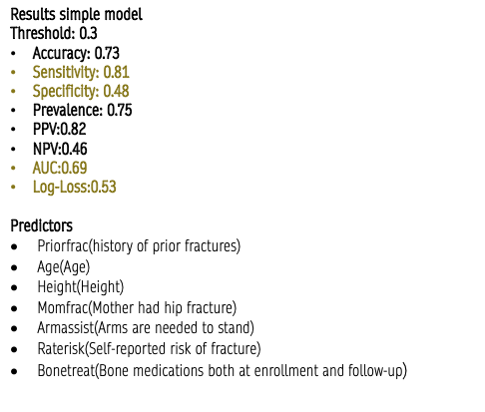
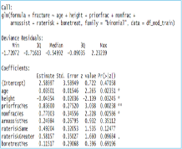
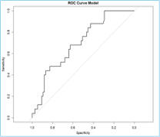
Recap and the threshold
STAt2_FINAL PROJECT

Slide 64
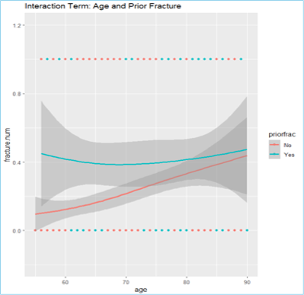
Model approach with interaction terms
STAt2_FINAL PROJECT
Analysis of Age and History of Prior Fracture
Unique pattern between having a prior fracture or not
Downward trend for individuals with a prior fracture
Upward trend for individuals without a history of a prior fracture
Age and Priorfrac will be considered in the model

Slide 65
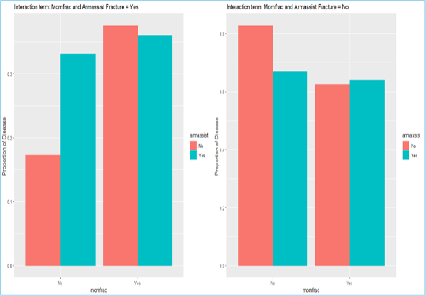
Model approach with interaction terms
STAt2_FINAL PROJECT
Analysis for Age, Mother had a hip fracture and Arms are needed to stand from a chair
There’s evidence that momfrac and armassist interact together
For women with fractures versus women that have not had fractures, there’s evidence of this fact.
Armassist and Momfrac will be considered in the complex model

Slide 66
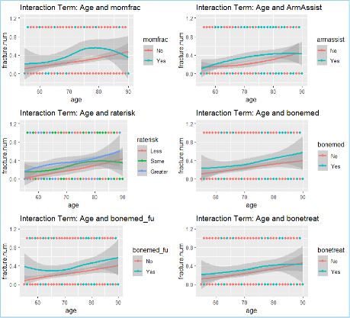
INTERACTIVE TERMS VISUALIZATION
STAt2_FINAL PROJECT
Interaction terms not needed
In general, there’s not a need for interaction terms for any of these cases.
There’s no indication of a UNIQUE trend between the predictors

Slide 67
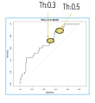
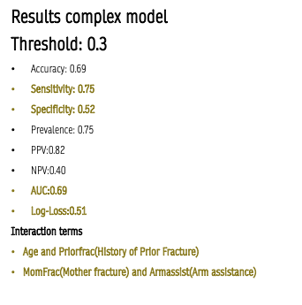
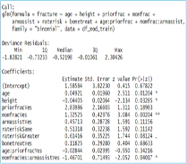
Complex model
STAt2_FINAL PROJECT

Slide 68
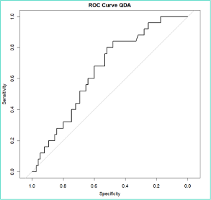
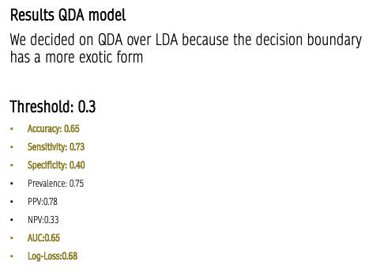
QDA model
STAt2_FINAL PROJECT

Slide 69
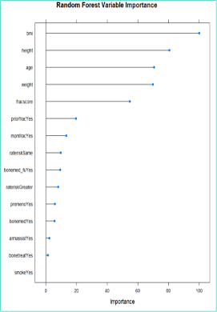
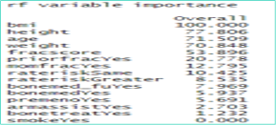
random forest
STAt2_FINAL PROJECT
Random forest is a powerful algorithm used for regression and classification
Random Forest uses the bagging method to create an ensemble of trees
It has feature selection incorporated
Effective for both categorical and numerical data, for our problem we have more categorical variables
KNN is Not as effective with categorical features
Predictors
We will consider all predictors because RF has feature selection internally
Variable importance gives an insight into most important predictors

Slide 70

random forest
STAt2_FINAL PROJECT
Results Random Forest model
All predictors included
Threshold: 0.3
Accuracy: 0.70
Sensitivity: 0.80
Specificity: 0.40
Prevalence: 0.75
PPV:0.80
NPV:0.40
AUC:0.65
Log-Loss:0.56

Slide 71

Random forest
STAt2_FINAL PROJECT

Slide 72


Model comparisons
STAt2_FINAL PROJECT

Slide 73
Model comparisons
STAt2_FINAL PROJECT
Model | ACCURACY | Sensitivity | SPECIFIVITY | PPV | NPV | PREVALENCE | AUC | LOG-LOSS
Simple model | 0.73 | 0.8133 | 0.48 | 0.8243 | 0.4615 | 0.75 | 0.6963 | 0.5306
Complex Model GLM Interaction | 0.69 | 0.7647 | 0.52 | 0.8235 | 0.4063 | 0.75 | 0.6989 | 0.5154
QDA | 0.65 | 0.7333 | 0.4 | 0.7857 | 0.3333 | 0.75 | 0.6552 | 0.6886
Random Forest | 0.7 | 0.8 | 0.4 | 0.8 | 0.4 | 0.75 | 0.6563 | 0.5609

Slide 74


Model comparisons
STAt2_FINAL PROJECT
Model | ACCURACY | Sensitivity | SPECIFIVITY | PPV | NPV | PREVALENCE | AUC | LOG-LOSS
Simple model | 0.73 | 0.8133 | 0.48 | 0.8243 | 0.4615 | 0.75 | 0.6963 | 0.5306
Complex Model GLM Interaction | 0.69 | 0.7647 | 0.52 | 0.8235 | 0.4063 | 0.75 | 0.6989 | 0.5154
QDA | 0.65 | 0.7333 | 0.4 | 0.7857 | 0.3333 | 0.75 | 0.6552 | 0.6886
Random Forest | 0.7 | 0.8 | 0.4 | 0.8 | 0.4 | 0.75 | 0.6563 | 0.5609

Slide 75
conclusion
Objective 1
Final model for interpretation purpose
STAt2_FINAL PROJECT
Objective 2
Best performed model
Improvements
Future consideration

Slide 76

Contacts
STAt2_FINAL PROJECT
Todd Garner : toddg@mail.smu.edu
Mai Dang: maid@mail.smu.edu
Carlos Estevez: cestevez@mail.smu.edu

Slide 77


Thank you
Todd Garner | Mai Dang | Carlos Estevez

